Slide 1
Collection Framework

Slide 2
Collection in Java
Any group of individual objects which are represented as a single unit is known as the collection of the objects. In Java, a separate framework named the “Collection Framework” has been defined in JDK 1.2 which holds all the collection classes and interface in it.
The Collection interface (java.util.Collection) and Map interface (java.util.Map) are the two main “root” interfaces of Java collection classes.
What is a Framework?
A framework is a set of classes and interfaces which provide a ready-made architecture to store and manipulate objects.
Advantages of the Collection Framework:
Consistent API
Reduces programming effort
Increases program speed and quality

Slide 3
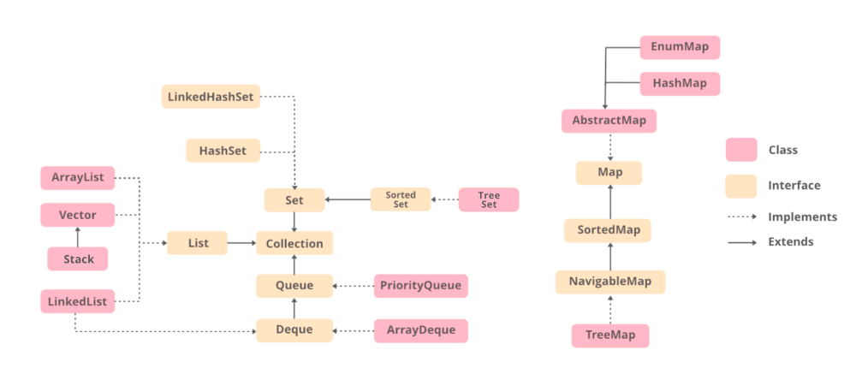
Hierarchy of Collection framework

Slide 4
Methods in collection interface
add(Object) This method is used to add an object to the collection.
addAll(Collection c) This method adds all the elements in the given collection to this collection.
clear() This method removes all of the elements from this collection.
contains(Object o) This method returns true if the collection contains the specified element.
containsAll(Collection c) This method returns true if the collection contains all of the elements in the given collection.
equals(Object o) This method compares the specified object with this collection for equality.
hashCode() This method is used to return the hash code value for this collection.
isEmpty() This method returns true if this collection contains no elements.
iterator() This method returns an iterator over the elements in this collection.
max() This method is used to return the maximum value present in the collection.
remove(Object o) This method is used to remove the given object from the collection. If there are duplicate values, then this method removes the first occurrence of the object.
removeAll(Collection c) This method is used to remove all the objects mentioned in the given collection from the collection.
removeIf(Predicate filter) This method is used to remove all the elements of this collection that satisfy the given predicate.
retainAll(Collection c) This method is used to retain only the elements in this collection that are contained in the specified collection.
size() This method is used to return the number of elements in the collection.
toArray() This method is used to return an array containing all of the elements in this collection.

Slide 5
List Interface: This is a child interface of the collection interface. This interface is dedicated to the data of the list type in which we can store all the ordered collection of the objects. This also allows duplicate data to be present in it. This list interface is implemented by various classes like ArrayList, Vector, Stack, etc. Since all the subclasses implement the list, we can instantiate a list object with any of these classes. For example,
List <T> al = new ArrayList<> ();
List <T> ll = new LinkedList<> ();
List <T> v = new Vector<> ();
Where T is the type of the object

Slide 6
ArrayList: ArrayList provides us with dynamic arrays in Java. Though, it may be slower than standard arrays but can be helpful in programs where lots of manipulation in the array is needed. The size of an ArrayList is increased automatically if the collection grows or shrinks if the objects are removed from the collection. Java ArrayList allows us to randomly access the list. ArrayList can not be used for primitive types, like int, char, etc. We will need a wrapper class for such cases.
LinkedList: LinkedList class is an implementation of the LinkedList data structure which is a linear data structure where the elements are not stored in contiguous locations and every element is a separate object with a data part and address part. The elements are linked using pointers and addresses. Each element is known as a node.

Slide 7
import java.io.*;
import java.util.*;
class CoDemo {
public static void main(String[] args)
{
ArrayList<Integer> al = new ArrayList<Integer>();
// Appending new elements at the end of the list
for (int i = 1; i <= 5; i++)
al.add(i);
System.out.println(al);
// Remove element at index 3
al.remove(3);
// Displaying the ArrayList after deletion
System.out.println(al);
// Printing elements one by one
for (int i = 0; i < al.size(); i++)
System.out.print(al.get(i) + " ");
}
}
Output:
[1, 2, 3, 4, 5]
[1, 2, 3, 5]
1 2 3 5

Slide 8
import java.io.*;
import java.util.*;
class CoDemo{
public static void main(String[] args)
{
LinkedList<Integer> ll = new LinkedList<Integer>();
// Appending new elements at the end of the list
for (int i = 1; i <= 5; i++)
ll.add(i);
// Printing elements
System.out.println(ll);
// Remove element at index 3
ll.remove(3);
// Displaying the List after deletion
System.out.println(ll);
// Printing elements one by one
for (int i = 0; i < ll.size(); i++)
System.out.print(ll.get(i) + " ");
}
}
Output:
[1, 2, 3, 4, 5]
[1, 2, 3, 5]
1 2 3 5

Slide 9
Queue Interface: As the name suggests, a queue interface maintains the FIFO(First In First Out) order similar to a real-world queue line. This interface is dedicated to storing all the elements where the order of the elements matter. For example, whenever we try to book a ticket, the tickets are sold on a first come first serve basis. Therefore, the person whose request arrives first into the queue gets the ticket. There are various classes like PriorityQueue, ArrayDeque, etc. Since all these subclasses implement the queue, we can instantiate a queue object with any of these classes.
For example,
Queue <T> pq = new PriorityQueue<> ();
Queue <T> ad = new ArrayDeque<> ();
Where T is the type of the object.

Slide 10
The most frequently used implementation of the queue interface is the PriorityQueue.
Priority Queue: A PriorityQueue is used when the objects are supposed to be processed based on the priority. It is known that a queue follows the First-In-First-Out algorithm, but sometimes the elements of the queue are needed to be processed according to the priority and this class is used in these cases. The PriorityQueue is based on the priority heap. The elements of the priority queue are ordered according to the natural ordering, or by a Comparator provided at queue construction time, depending on which constructor is used.

Slide 11
import java.util.*;
class CoDemo {
public static void main(String args[])
{
PriorityQueue<Integer> pQueue = new PriorityQueue<Integer>(); // Creating empty priority queue
pQueue.add(10); // Adding items to the pQueue using add()
pQueue.add(20);
pQueue.add(15);
// Printing the top element of PriorityQueue
System.out.println(pQueue.peek());
// Printing the top element and removing it from the PriorityQueue container
System.out.println(pQueue.poll());
System.out.println(pQueue.peek()); // Printing the top element again
}
}
Output:
10
10
15

Slide 12
Deque Interface:
This is a very slight variation of the queue data structure. Deque, also known as a double-ended queue, is a data structure where we can add and remove the elements from both ends of the queue. This interface extends the queue interface. The class which implements this interface is ArrayDeque. Since ArrayDeque class implements the Deque interface, we can instantiate a deque object with this class. For example,
Deque<T> ad = new ArrayDeque<> ();
Where T is the type of the object.

Slide 13
The class which implements the deque interface is ArrayDeque.
ArrayDeque: ArrayDeque class which is implemented in the collection framework provides us with a way to apply resizable-array. This is a special kind of array that grows and allows users to add or remove an element from both sides of the queue. Array deques have no capacity restrictions and they grow as necessary to support usage.

Slide 14
import java.util.*;
public class ArrayDequeDemo {
public static void main(String[] args)
{
ArrayDeque<Integer> de_que = new ArrayDeque<Integer>(10);
de_que.add(10); // // add() method to insert
de_que.add(20);
de_que.add(30);
de_que.add(40);
de_que.add(50);
System.out.println(de_que);
de_que.clear();
// addFirst() method to insert the elements at the head
de_que.addFirst(564);
de_que.addFirst(291);
// addLast() method to insert theelements at the tail
de_que.addLast(24);
de_que.addLast(14);
System.out.println(de_que);
}
}
Output:
[10, 20, 30, 40, 50]
[291, 564, 24, 14]

Slide 15
Set Interface: A set is an unordered collection of objects in which duplicate values cannot be stored. This collection is used when we wish to avoid the duplication of the objects and wish to store only the unique objects. This set interface is implemented by various classes like HashSet, TreeSet, LinkedHashSet, etc. Since all the subclasses implement the set, we can instantiate a set object with any of these classes. For example,
Set<T> hs = new HashSet<> ();
Set<T> lhs = new LinkedHashSet<> ();
Set<T> ts = new TreeSet<> ();
Where T is the type of the object.

Slide 16
HashSet: The HashSet class is an inherent implementation of the hash table data structure. The objects that we insert into the HashSet do not guarantee to be inserted in the same order. The objects are inserted based on their hashcode. This class also allows the insertion of NULL elements.

Slide 17
import java.util.*;
public class HashSetDemo {
public static void main(String args[])
{
// Creating HashSet and // adding elements
HashSet<String> hs = new HashSet<String>();
hs.add(“Java");
hs.add(“programming");
hs.add(“Language");
hs.add("Is");
hs.add("Very helpful");
// Traversing elements
Iterator<String> itr = hs.iterator();
while (itr.hasNext()) {
System.out.println(itr.next());
}
}
}
Output:
Very helpful
Java
Programming
Is
Language

Slide 18
LinkedHashSet: A LinkedHashSet is very similar to a HashSet. The difference is that this uses a doubly linked list to store the data and retains the ordering of the elements.
public class LinkedHashSetDemo {
public static void main(String args[])
{
LinkedHashSet<String> lhs = new LinkedHashSet<String>();
lhs.add(“Programming");
lhs.add(“Language");
lhs.add(“Java");
lhs.add("Is");
lhs.add("Very helpful");
Iterator<String> itr = lhs.iterator();
while (itr.hasNext()) {
System.out.println(itr.next());
}
}
}
Output:
Programming
Language
Java
Is
Very helpful

Slide 19
Sorted Set Interface: This interface is very similar to the set interface. The only difference is that this interface has extra methods that maintain the ordering of the elements. The sorted set interface extends the set interface and is used to handle the data which needs to be sorted. The class which implements this interface is TreeSet. Since this class implements the SortedSet, we can instantiate a SortedSet object with this class. For example,
SortedSet<T> ts = new TreeSet<> ();
Where T is the type of the object.

Slide 20
TreeSet: The TreeSet class uses a Tree for storage. The ordering of the elements is maintained by a set using their natural ordering whether or not an explicit comparator is provided. This must be consistent with equals if it is to correctly implement the Set interface. It can also be ordered by a Comparator provided at set creation time, depending on which constructor is used.
public class TreeSetDemo {
public static void main(String args[])
{
TreeSet<String> ts = new TreeSet<String>();
ts.add(“Java");
ts.add(“Programming");
ts.add("Is");
ts.add("Very helpful");
Iterator<String> itr = ts.iterator();
while (itr.hasNext()) {
System.out.println(itr.next());
}
}
}
Output:
Java
Programming
Is
Very helpful

Slide 21
Map Interface: A map is a data structure that supports the key-value pair mapping for the data. This interface doesn’t support duplicate keys because the same key cannot have multiple mappings. A map is useful if there is data and we wish to perform operations on the basis of the key. This map interface is implemented by various classes like HashMap, TreeMap, etc. Since all the subclasses implement the map, we can instantiate a map object with any of these classes. For example,
Map<T> hm = new HashMap<> ();
Map<T> tm = new TreeMap<> ();
Where T is the type of the object.

Slide 22
The frequently used implementation of a Map interface is a HashMap.
HashMap: HashMap provides the basic implementation of the Map interface of Java. It stores the data in (Key, Value) pairs. To access a value in a HashMap, we must know its key. HashMap uses a technique called Hashing. Hashing is a technique of converting a large String to a small String that represents the same String so that the indexing and search operations are faster. HashSet also uses HashMap internally.

Slide 23
import java.util.*;
public class HashMapDemo {
public static void main(String args[])
{
HashMap<Integer, String> hm = new HashMap<Integer, String>();
hm.put(1, “Java");
hm.put(2, “Programming");
hm.put(3, “Java");
System.out.println("Value for 1 is " + hm.get(1)); // Finding the value for a key
for (Map.Entry<Integer, String> e : hm.entrySet())
System.out.println(e.getKey() + " " + e.getValue());
}
}
Output
Value for 1 is Java
1 Java
2 Programming
3 Java

Slide 24
The LinkedHashMap Class is just like HashMap with an additional feature of maintaining an order of elements inserted into it. HashMap provided the advantage of quick insertion, search, and deletion but it never maintained the track and order of insertion which the LinkedHashMap provides where the elements can be accessed in their insertion order.

